Slide 1

Design Pattern
Group Members :
Rukhsar Ahmad 20P-0085
Sartaj Ahmad 20P-0112
Huzaifa Waheed 20P-0067

Slide 2
Bridge Pattern
Definition:
The bridge pattern is a design pattern used in software engineering that is meant to "decouple an abstraction from its implementation so that the two can vary independently", introduced by the Gang of Four.

Slide 3
Explanation
The Bridge design pattern allows you to separate the abstraction from the implementation. It is a structural design pattern.
There are 2 parts in Bridge design pattern :
Abstraction
Implementation

Slide 4
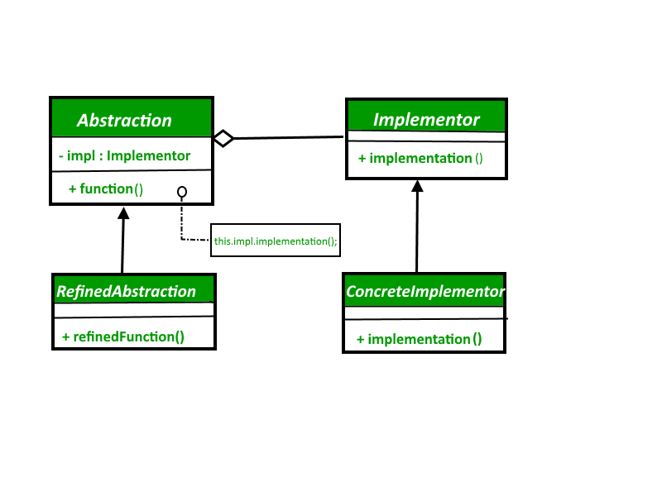
Types

Slide 5
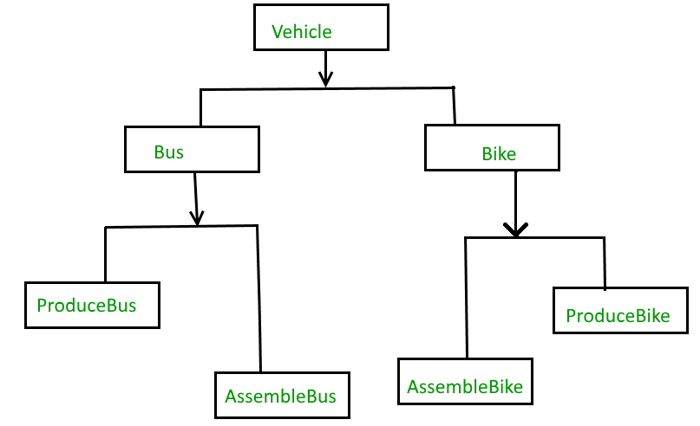
Problem:

Slide 6
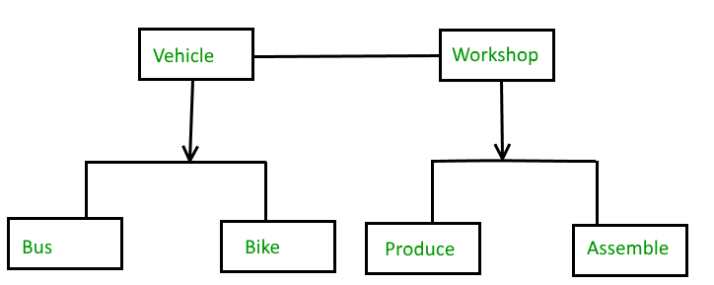
Solution:

Slide 7
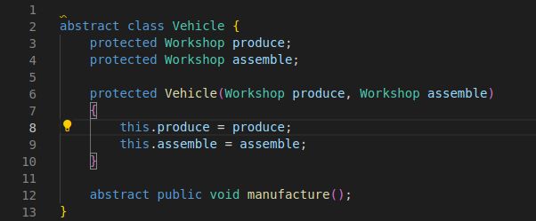
Code Demo

Slide 8
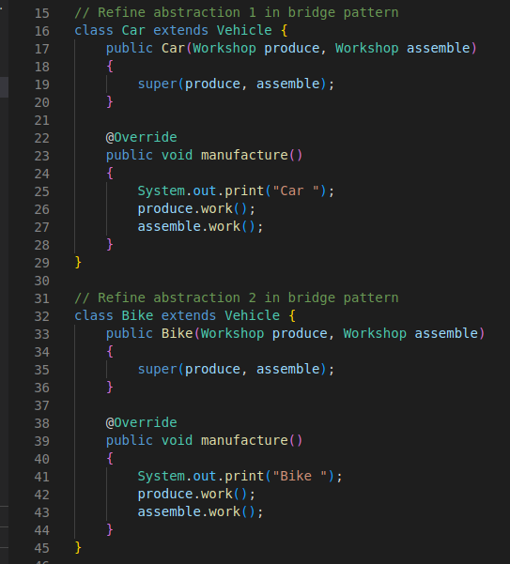
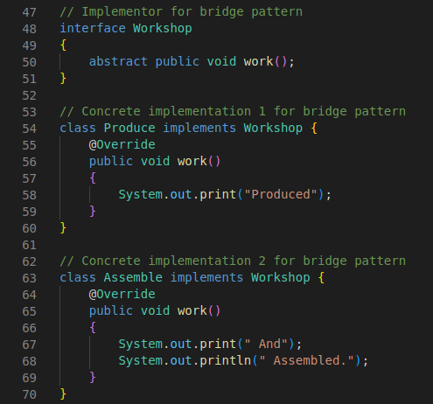

Slide 9
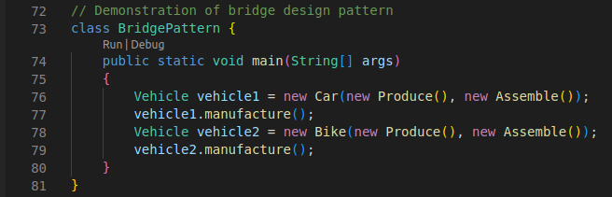
Code Demo

Slide 10
Advantages
Bridge pattern decouple an abstraction from its implementation so that the two can vary independently.
It is used mainly for implementing platform independence features.
It adds one more method level redirection to achieve the objective.

Slide 11
Disadvantages
Bridge pattern implementation increases code complexity.
Interfaces with only single implementation
Multiple indirection

Slide 12

Thank You

